Slide 1

Team Promotion Alarm Clock
Simple Habits

Slide 2

Agenda
Approach
Project Management
Technical
Architecture
Testing
Demo

Slide 3

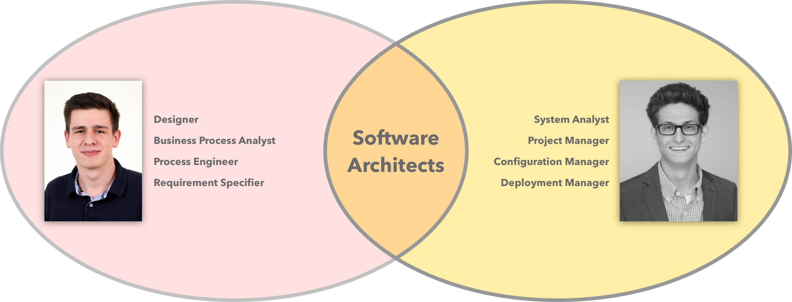
Team
Notes:
NUR 2!!!!!!
(worth the project)

Slide 4

Approach

Slide 5

Approach - Vision
Real – Time
Simple
Assistance
Reliable
Smart

Slide 6

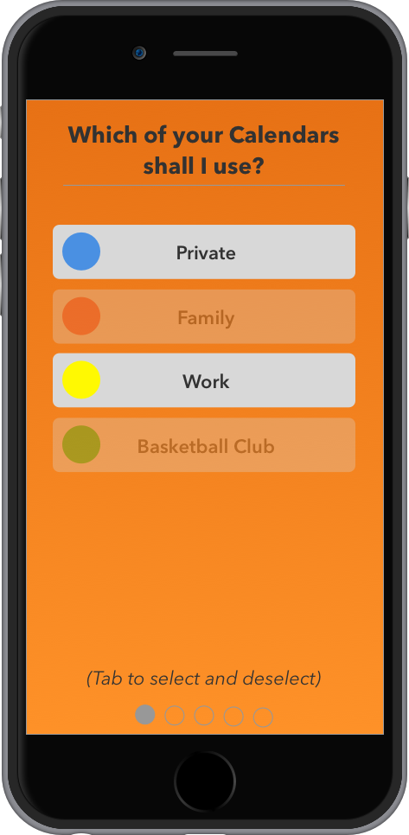
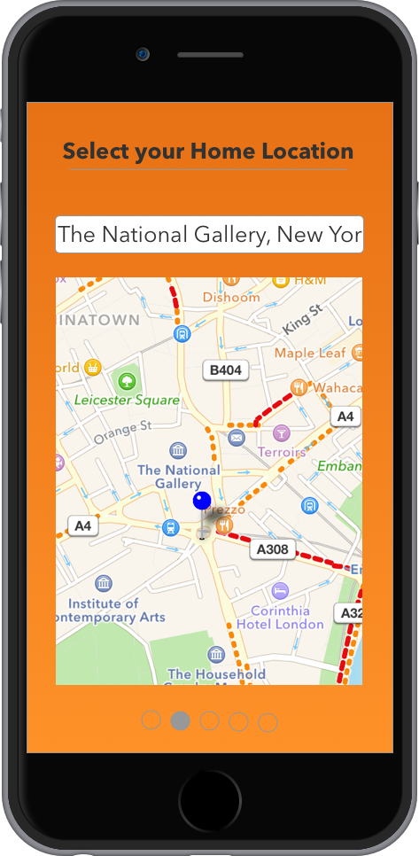
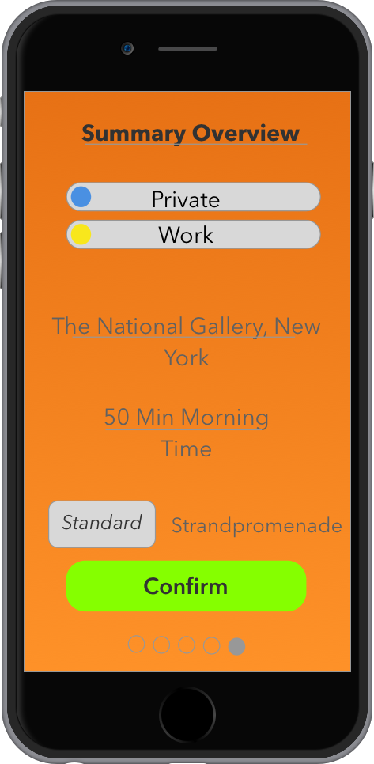
Approach – Mock Ups

Slide 7

Project Management

Slide 8
Project Management – Methodology
Why not Waterfall?

Slide 9
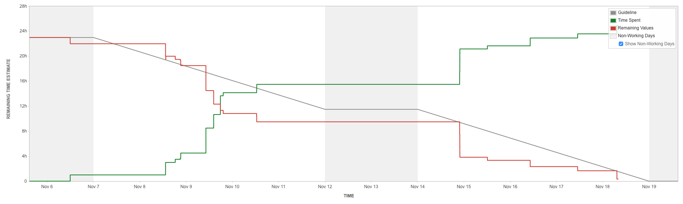
Project Management – Scrum Tool

Slide 10
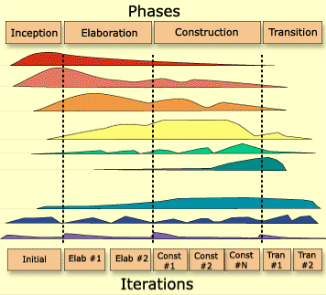
Project Management – Rational Unified Process
Long Term Planning
Disciplines
Business Modelling
Requirements
Analysis & Design
Implementation
Test
Deployment
Configuration &
Change Management
Environment
Project Management

Slide 11
Project Management – Risk Management
Notes:
Impact 0-10
Faktorberechnung durch Multiplikation

Slide 12
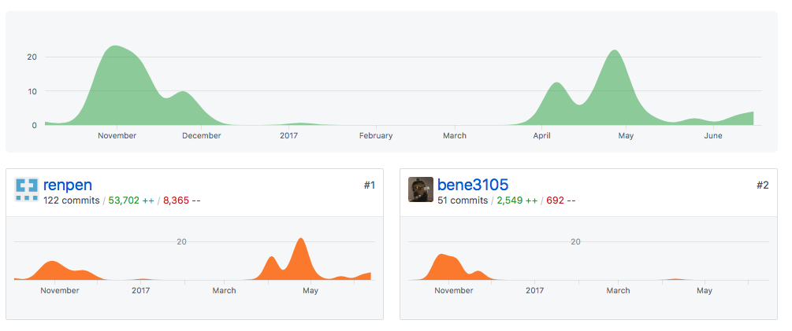

Project Management – Version Control
Notes:
Updaten

Slide 13
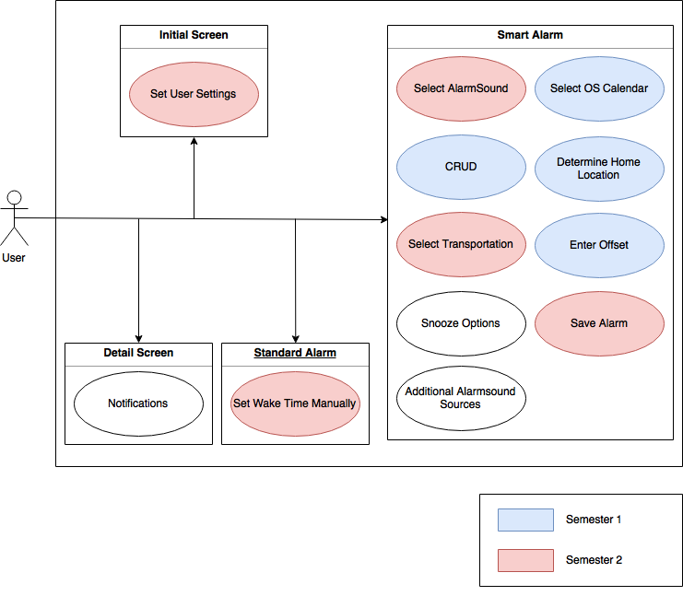
Project Management – Overall Use Case Diagram

Slide 14
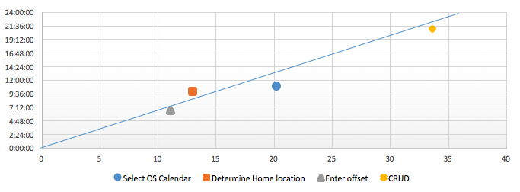

Project Management –Time Estimation
Based on Function Points Calculation

Slide 15

Technical Environment
Notes:
After Benedikt showed you the ProjectManagment Part. I will enlighten you the Technical Site of our projekct
I will start with the Technical Environment

Slide 16
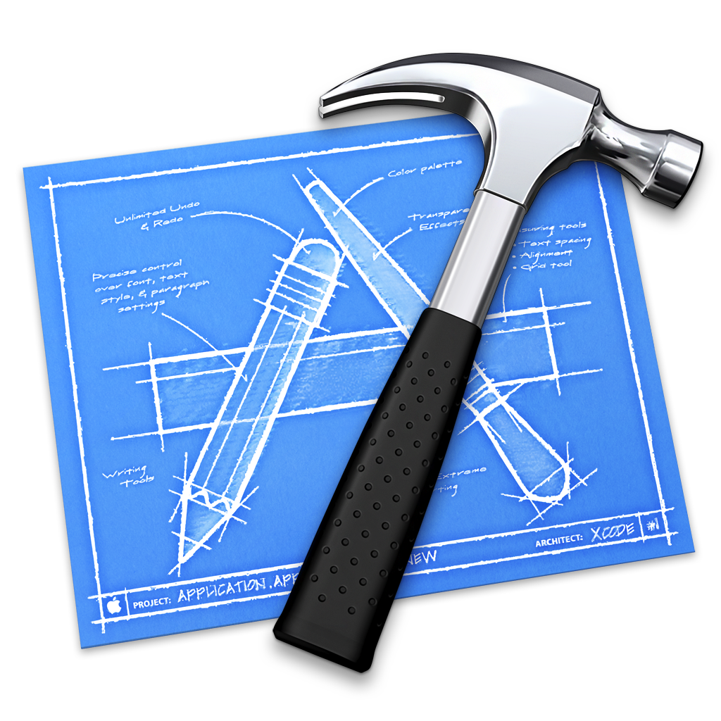

Technical Environment – iOS
Notes:
Bases on Swift
Objective C too old
Swift the Standard for Apple Universe
Swift -> xCode
xCode offers huge amount of tools for succesfull Apple Development
Simulator
Signing Process
Performance Testing
The App we developed is based on Swift. We could also choose Objective C too implement the App. We choosed Swift because it is Apple programming language for all their devices. With swift there comes the Development Platform (IDE) xCode. That´s the Logo on the Left. There are some third party DIE´s for developing Swift Applications. These third party apps doens´t have the huge amount of functionalities xCode offers for Apple Development by far.

Slide 17
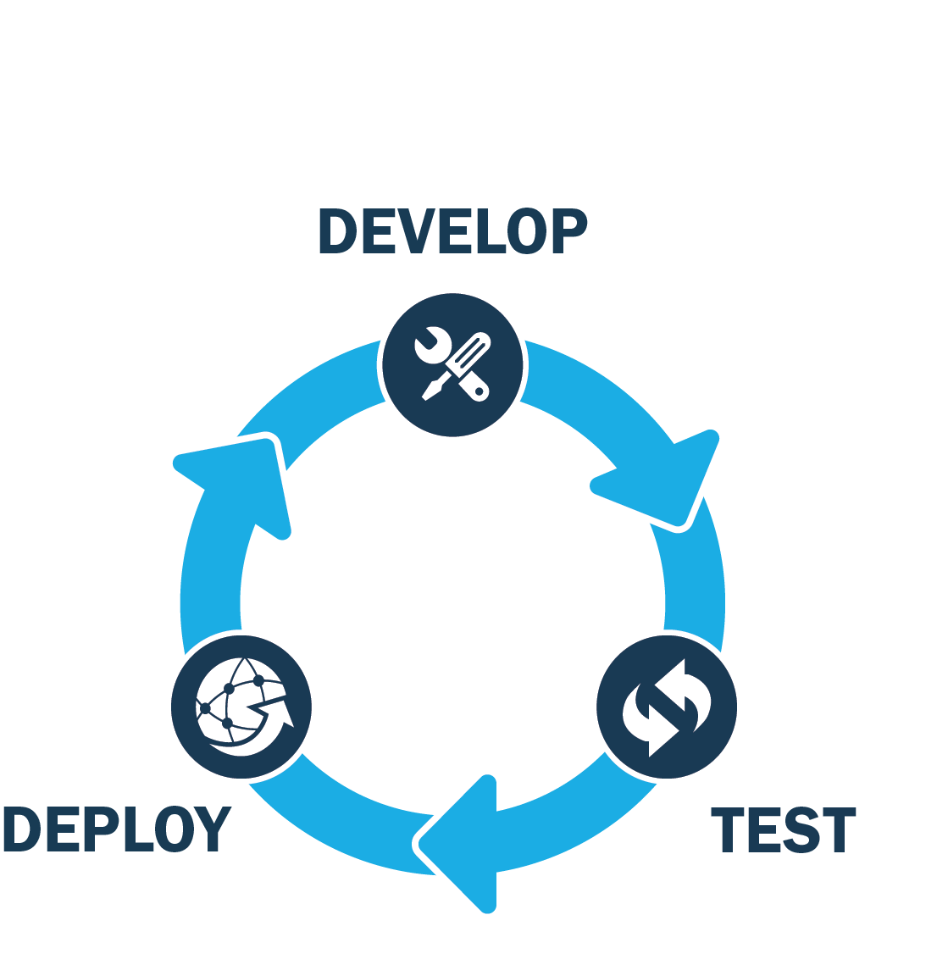
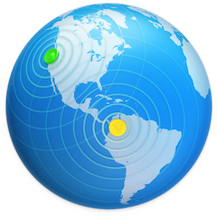
Technical Environment – Continuous Integration
Notes:
Way to develop
Lifecycle of CI
Apple Universe a little different. Jenkins not possible
Using Apple Universe compatible Software -> xCode Server
xCode Server comes with mac OS Server
xCode Server
Comparable with Jenkins
Autmated Testing with xCode Bot
No deployment -> deployment apps -> appstore -> cannot be automated
Continuous Integration. That´s the way to develop. On the left picture you can see the lifecycle how CI is performed. In the Apple Universe it´s a little bit different to other Software Projects. Normally you would use a Jenkins to inmplenent Continuoius integration. There are many aspect why this is not working with iOS Apps. iOS development is verry deep integrated with xCode. For example run/debug a app in a simulator only works with xCode. Additionally signing of a App just work with xCode,too. Of course Apple offers a way to do Continous Integration anyhow. Apple Product for this is called Mac OS Server. Within the Application MAC OS Server you can define Testing Suites and Testing Bots to run the test of your Projects every time changes are applied.

Slide 18
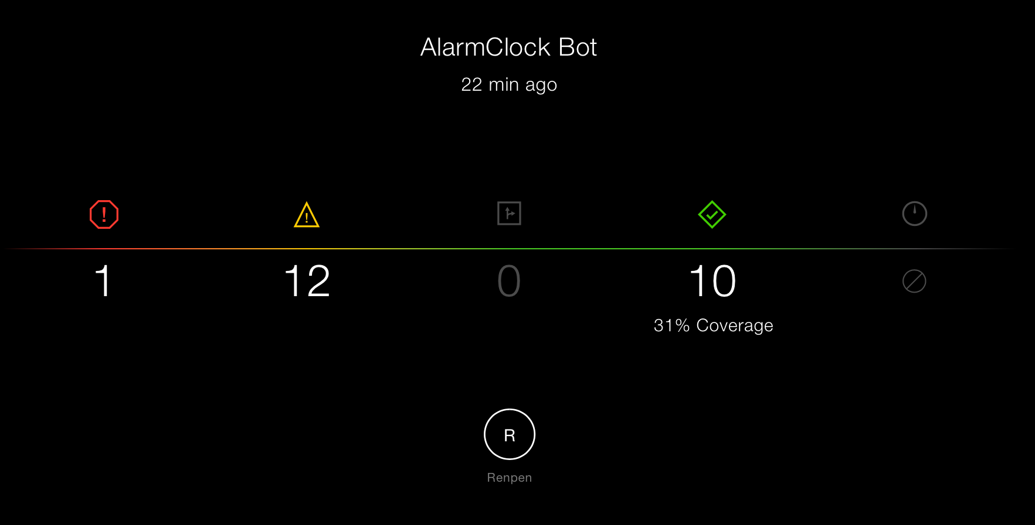
Technical Environment – CI Insights
Notes:
Dashboard xCode Server
Code Coverage
Successfull tests
Failed tests
when the test were performed
With the xCode Bots on the xCode server you can define automated testing and archiving. Here you can see how the Dashbord of the xCode Server looks like. As you can see it shows you how much code-warnings you have and how high your code coverage is.

Slide 19
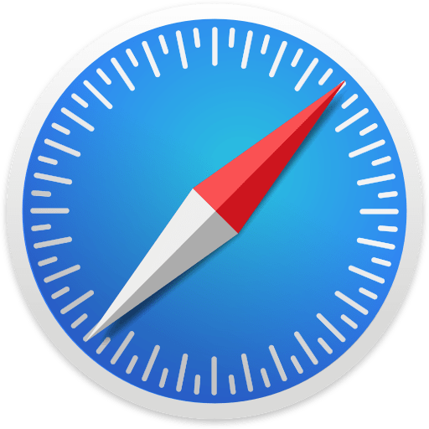
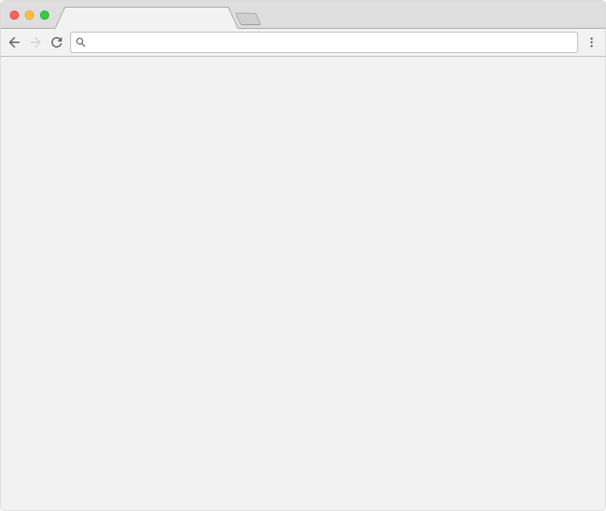
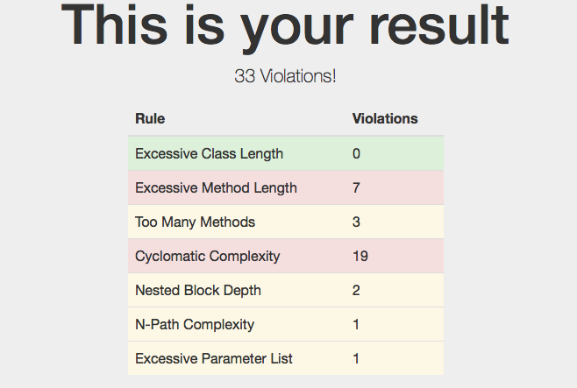
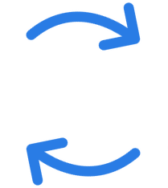

Technical Environment – Metrics
Browser
Parser
Metrics Measurement (Taylor)
Project code base
Notes:
Automated testing and assured funktionalities through tests -> need to look at quality
Good code is important
metrics measue, certain criteria
Goal -> good code
Apple Universer -> no good tools
Taylor measues -> output JSON
Built Parser to show in nice User Interface
---→ When there are no tools that accomplish the things we want to do, we simple develop them by our own.
When we have automated testings and assured functionalities thorugh test´s it is improntant to look at the general quality of the Code. Metrics meassure how good the Code is according to a certain criteria. Only good code is good maintainable code and will live long. The goal is to get verry good code. As always in the Apple Univers it isn´t verry easy to apply common metrics because the tools for that doesn´t exists. We used a tool called Taylor to get a basic measuredment of our code. The output of the tool Taylor is a json file. We haven´t got a tool to show the metrics of our project in a simple easy User Interface. So we simply developed it by our own. You can see the result of our Taylorparser in the Picture on the right.

Slide 20

Architecture
Notes:
Talked Technical Environment
Talk about our app and how we designed it
I talked a lot about our Technical Environment. Let´s actually talk about our app and how we architected it.

Slide 21
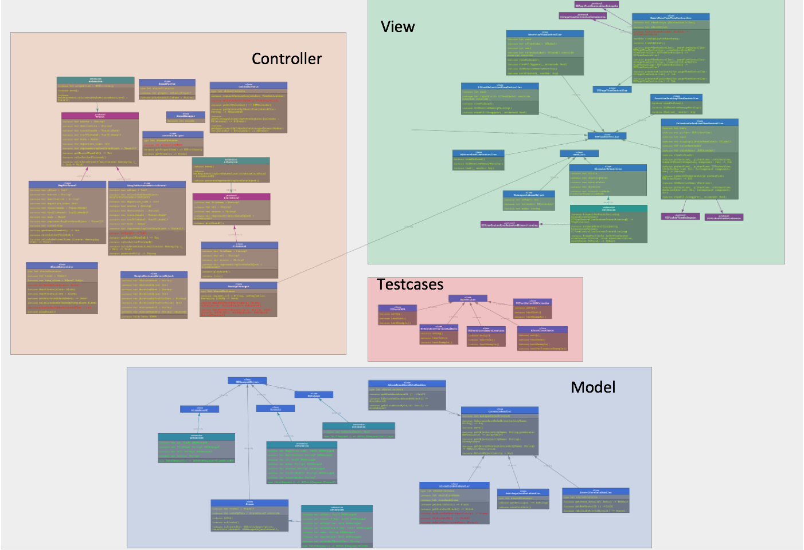
Architecture – Class Diagram
Notes:
A lot of classes
Looks complex -> it is
MVC implemented
To time intense to look into detail -> see our Software Architecture Document -> detailed look into Architecture
As you can see in our classDiagram we developed a lot classes and implement a software Pattern called Model-View-Controller. The different Architecture elements are sorrounded with the different colors as you can see. It would be too time intense to show you our architecture in detail. You are welcome too look at our Software Architecture Document where you can have more detailed look at the different parts of our Architecture.

Slide 22
Architecture – Patterns
Decorator
State
Visitor
Singleton
Factory
Observer
Iterator
Notes:
Software Patterns -> important tool for developers
Class diagram verry complex
Create simple usable code -> use pattern
Patterns -> constructs how certain functionality is implemented
Complex behavior simpliefied with patterns
Example Patterns are
Verry important tool for a developer are Software-Patterns. As you have seen in our class-diagramm software can get verry complex. Komplex code that is written in a complex structure isn´t good to use by someone who don´t know the code verry well and it is not well maintainable, too. Software-Patterns are an easy way to implement complex issues in a good and plausible way. Patterns are constructs that define how a certain type of functionlaity is implemented. The picture with the circys is an analogy. It shows complex behaviour simplified with a pattern. Examples for Patterns are

Slide 23
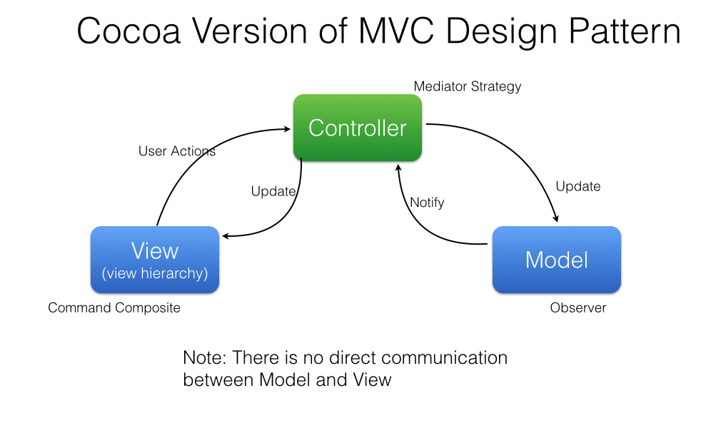
Architecture – MVC Pattern
In Context of Swift
Notes:
2 important pattern
MVC -> splitting the App in 3 parts
Classdiagram -> we applied this
Develop each part indepentently; API needs to be defined
It´s a capsuations from specific parts of the Application to the other parts.
View doesn´t need to know logic in Controller
A verry important Patternis MVC. It´s a pattern to split the application in 3 different parts. The View, the Controller, and the Model. As you have seen in our class diagramm, we applied these pattern in our application. With MVC it is possible to develop each of the three parts independet from the other. There only needs to be defined API´s how the three parts will interact with each other. The rest is capsuled form the other parts. The View for example doesn´t need to know how the Controller implements the Logic and does the Calculations.

Slide 24
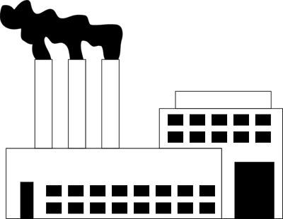

Architecture – Fabricate Pattern
Notes:
Capsulation of objects
Gets related pattern and fabricates new objects with the capsuled logic for it
Applies parameter
Implemented fabirc pattern -> coredata capsulation
Just give persistent object
Furthermore, an other pattern that we used often in our Application is the fabriate pattern. A fabric pattern get´s a request to fabricate a kind of object. With a fabric pattern you can capsule objects verry nice. The fabric get´s then the related pattern for the object and creates a new object based on the pattern. While fabricating the object it applies the parameters that were send with the request. We implemented the fabric pattern for example to handle persistent functions with CoreData. We capsuled all the interactions with internal CoreData structure in fabric patterns that we simple need to tell the fabric to give us a persistendable object.

Slide 25
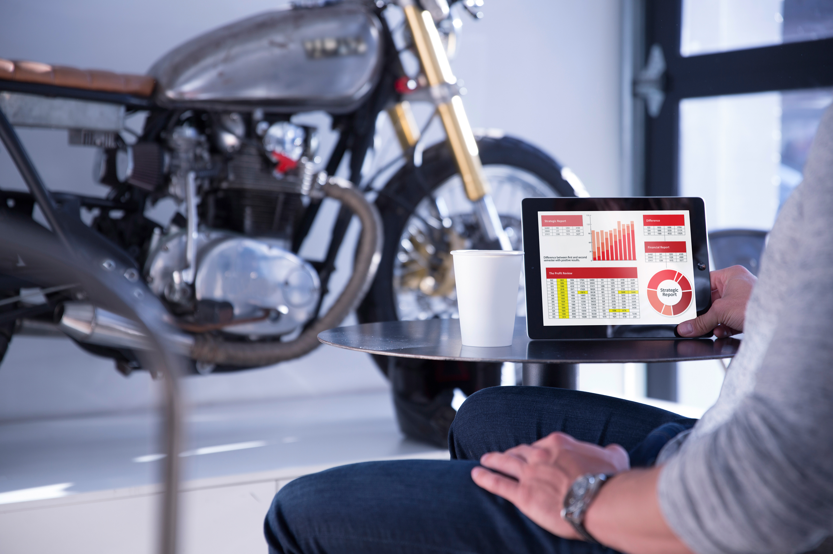
Testing Infrastructure
Notes:
CI -> autoamte testing
How are the test developed
I talked with you about our Continious Integration Infrastructure. Now want to look a little bit how we develop test for our Application.

Slide 26
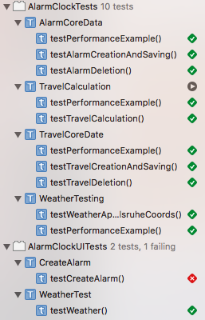
Testing Infrastructure – Xcode Unit- & UI-Testing
Notes:
Assume -> Apple Universe not easy
Cucumber -> xCode UI Tests
xCode Unit- Tests
Both in Swift
xCode plays a strong role here, too.
Result of the tests -> see right picutre
Huge Documentation of our tests -> see our test-plan for details.
As you will assume testing in the apple universe isnt´t easy as it is in other langugaes or environments. Ui-Tests for Example are often developed as Cucumber test. That is not possible in for an iOS application. Furthermore, xCode plays as well a strong role in testing an iOS app. With xCode you can write so called xCode UI-Test. These UI-Test are written in Swift. There is also the possibliy to develop so called xCode Unit-Tests. When you run the tests you get an result that looks like the picture on the right. There you can see which test were succesfull and which don´t. We have a huge Documentation of our Tests that you can acces through our Test-Plan.

Slide 27
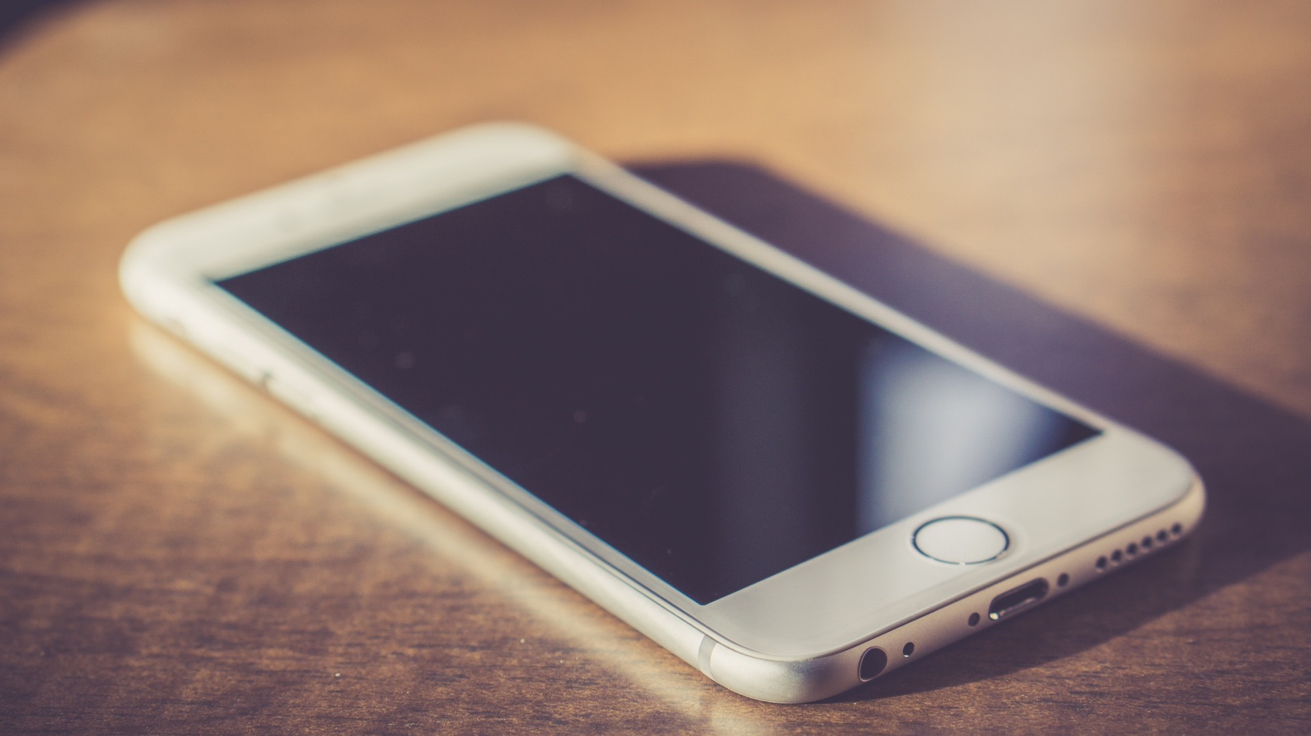
Demo
Notes:
DEMO

Slide 28
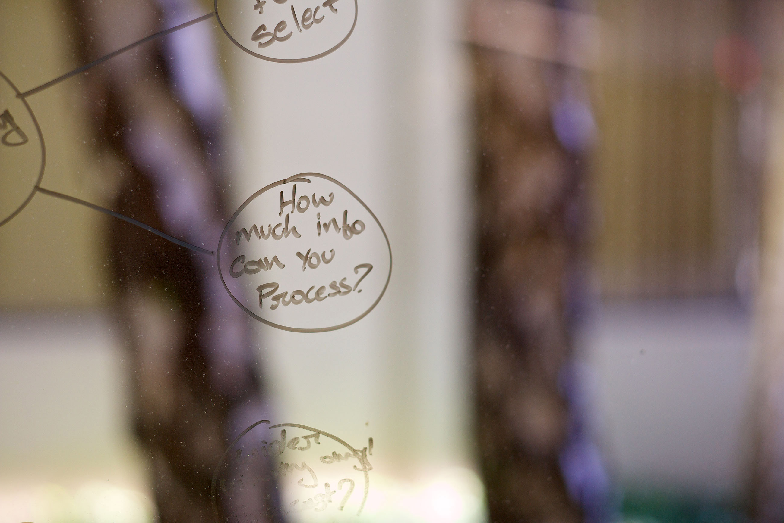
Questions

